Slide 1
Best of ASH 2022:
Indolent lymphomas
Jorge J. Castillo, MD
Associate Professor of Medicine
Harvard Medical School
JorgeJ_Castillo@dfci.harvard.edu

Slide 2
Disclosures
Company | Research support | Employee | Consultant | Stockholder | Speaker’s Bureau | Scientific Advisory Board
AbbVie | X |  | X |  |  | X
AstraZeneca | X
BeiGene | X |  | X |  |  | X
Cellectar | X |  | X |  |  | X
Janssen |  |  | X
Kite |  |  |  |  |  | X
LOXO | X |  |  |  |  | X
Pharmacyclics | X |  | X |  |  | X
Roche |  |  | X
TG Therapeutics | X

Slide 3
Follicular lymphoma

Slide 4
Mosunetuzumab Monotherapy Demonstrates
Durable Efficacy with a Manageable Safety
Profile in Patients with Relapsed/Refractory Follicular Lymphoma who Received ≥2 Prior Therapies: Updated Results from a Pivotal Phase II Study
IV mosunetuzumab administered in 21-day cycles
with step-up dosing in C1
Fixed-duration treatment: 8 cycles if CR after C8; 17 cycles
if PR/SD after C8
Re-treatment with mosunetuzumab permitted at relapse for patients who achieved CR
No mandatory hospitalization
D15: 60mg
D1: 60mg
D1: 30mg
D1: 30mg
D8: 2mg
D1: 1mg
C1
C2
C3
C8/17
Bartlett et al. ASH 2022: 610

Slide 5
Response rates
Efficacy endpoint in the overall population by investigator assessment; % (95% CI) | N=90
ORR | 78% (68–86)
CR | 60% (49–70)
Time to first response (median [range]): 1.4 months (1.0–11)
Time to first CR (median [range]): 3.0 months (1.0‒19)
Bartlett et al. ASH 2022: 610

Slide 6
Durability of responses
Efficacy endpoint by investigator assessment | N=90
Median DOR, months (range), n=70 24-month DOR (95% CI) | NR (21–NR) 53% (38–68)
Median DOCR, months (range), n=54 24-month DOCR (95% CI) | NR (23–NR) 63% (38–88)
Median PFS, months (range) 24-month PFS (95% CI) | 24 (12–NR) 48% (36–60)
Median OS, months (range) 24-month OS (95% CI) | NR (NR–NR) 87% (80–94)
DOR and DOCR
1.0
12-month remission rate: 82%
0.8
24-month remission rate: 63%
0.6
Probability
12-month remission rate: 67%
0.4
24-month remission rate: 53%
0.2
DOR
DOCR
0.0
0
2
4
6
8
10
12
14
16
18
20
22
24
26
28
30
32
34
Time (months)
Patients at risk
70
65
60
52
48
47
42
39
37
30
29
18
9
5
5
3
3
3
Patients at risk
54
53
50
43
42
37
35
31
28
22
19
10
5
4
4
2
2
2
Durable responses: majority of patients in remission after 2 years
Bartlett et al. ASH 2022: 610

Slide 7
CRS summary
CRS by ASTCT criteria | N=90
CRS (any grade) Grade 1 Grade 2 Grade 3 Grade 4 | 44% 26% 17% 1% 1%
Median time to CRS onset, hours (range) C1D1 C1D15 | 5.2 (1.2–24) 27 (0.1–391)
Median CRS duration, days (range) | 3 (1–29)
Corticosteroids for CRS management | 11%
Tocilizumab for CRS management | 8%
Events resolved | 100%
CRS by cycle and grade
C1
36%
23%
10%
6%
2%
C1D1–7
1mg
C1D8–14
2mg
C1D15–21
60mg
C2
60mg
C3+
30mg
Mosunetuzumab
dose
CRS was predominantly low grade and during Cycle 1
All CRS events resolved; no new events were reported with 10 months of additional follow-up
Bartlett et al. ASH 2022: 610

Slide 8
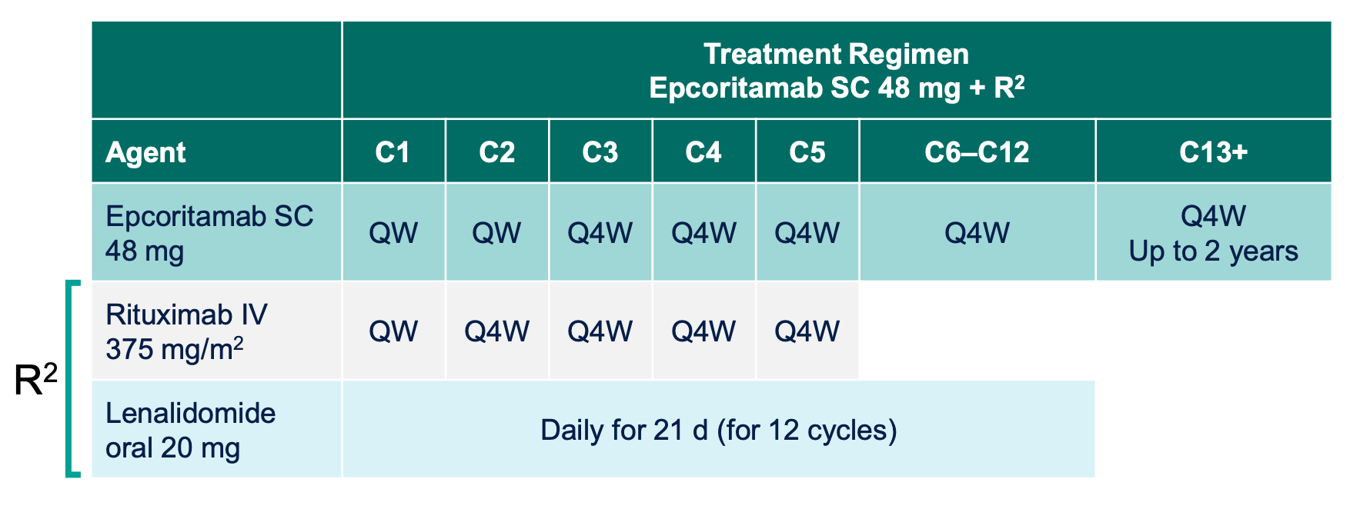
Epcoritamab + R²
Two cohorts:
Untreated FL N=41
R/R FL N=76
  Median prior lines 1 (1-9)
  Primary refractory 38%
  POD24 42%
24-hour hospitalization required for first full dose of epcoritamab
Falchi et al. ASH 2022 #609, 611

Slide 9
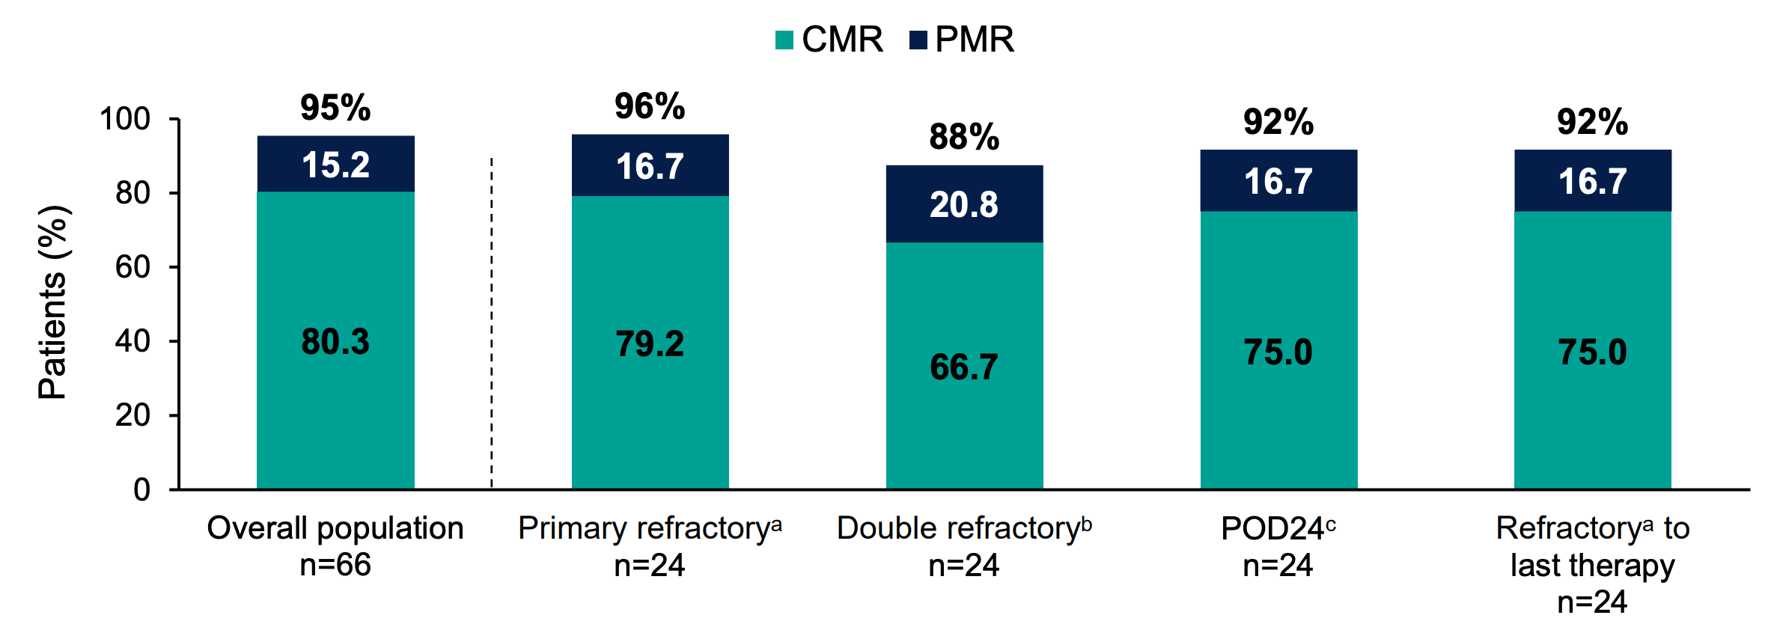
Epcoritamab + R² - Efficacy
 | Untreated | R/R
ORR | 94% | 95%
CRR | 86% | 80%
Falchi et al. ASH 2022 #609, 611

Slide 10
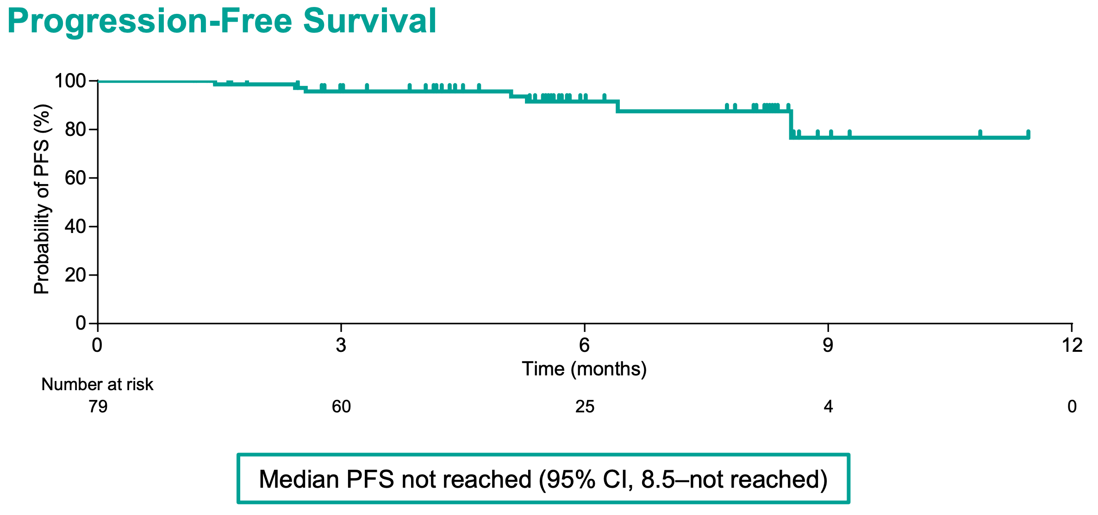
Epcoritamab + R²: R/R PFS
Falchi et al. ASH 2022 #609, 611

Slide 11
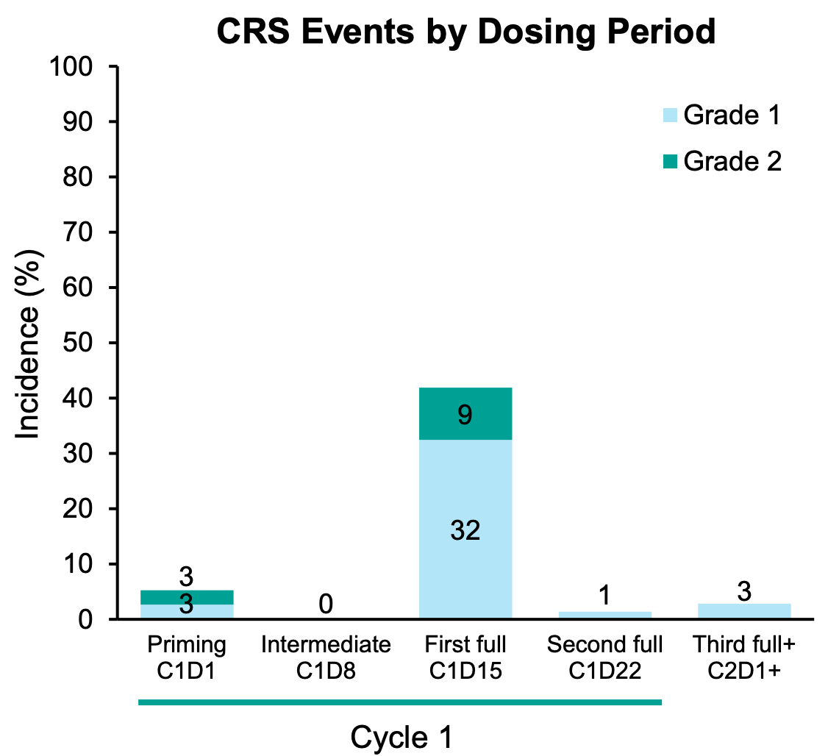
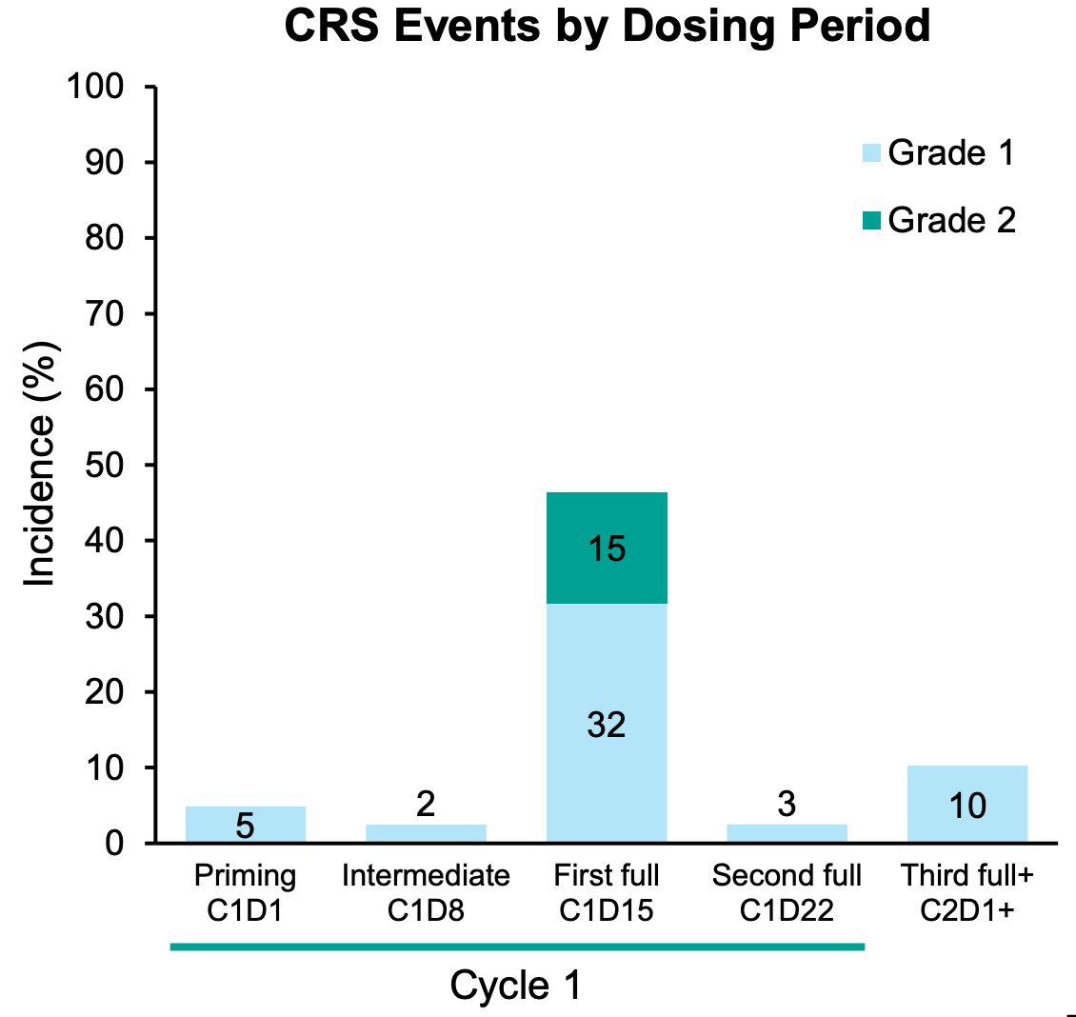
Epcoritamab + R²: Safety
R/R
Untreated
Falchi et al. ASH 2022 #609, 611

Slide 12
Follicular lymphoma: summary
Mosunetuzumab CR rate 60% with a 24-month duration of CR of 63% CRS manageable 18-month EFS 47% | Epcoritamab + R² CR rate >80% in untreated and R/R settings CRS manageable

Slide 13
Waldenström Macroglobulinemia

Slide 14
Ibrutinib and Venetoclax in Previously Untreated Waldenström Macroglobulinemia
Cycle 1
Ibrutinib 420 mg PO QD
Cycle 2
Ibrutinib 420 mg PO QD
Venetoclax weekly ramp up over 3 weeks
100-200-400 mg PO QD
Cycle 3-24
Ibrutinib 420 mg PO QD
Venetoclax 400 mg PO QD
Dose reductions were allowed for toxicity
Castillo et al. ASH 2022: 231

Slide 15
Response to therapy
p=0.15
ORR 100%
Major 93%
ORR 100%
Major 96%
ORR 100%
Major 89%
Castillo et al. ASH 2022: 231

Slide 16
Survival analysis
Median follow-up: 11 months
12-month PFS rate: 92%
12-month OS rate: 95%
Castillo et al. ASH 2022: 231

Slide 17
Safety
Adverse events | Grade 2 | Grade 3 | Grade 4 | Grade 5 | Total
Anemia | 1 | 2 |  |  | 3
Atrial fibrillation | 1 | 2 | 1 |  | 4
Diarrhea | 8 | 1 |  |  | 9
Reflux | 10 |  |  |  | 10
Mucositis | 7 | 2 |  |  | 9
Nausea | 5 |  |  |  | 5
Neutropenia | 1 | 10 | 3 |  | 14
Hyperphosphatemia | 8 |  |  |  | 8
Muscle/joint pain | 14 | 2 |  |  | 16
Skin rash | 6 |  |  |  | 6
Ventricular arrhythmia | 1 |  | 1 | 2 | 4
Laboratory TLS |  | 2 |  |  | 2
Adverse events observed in ≥3 patients and of clinical importance
n=45
Castillo et al. ASH 2022: 231
Notes:
“A study hold was placed on further accrual after the third ≥Grade 4 cardiac arrest / ventricular arrhythmia. Subsequently, all patients on active treatment were required to undergo cardiac evaluations.” “One patient developed a Grade 2 ventricular arrhythmia while undergoing a stress test”

Slide 18
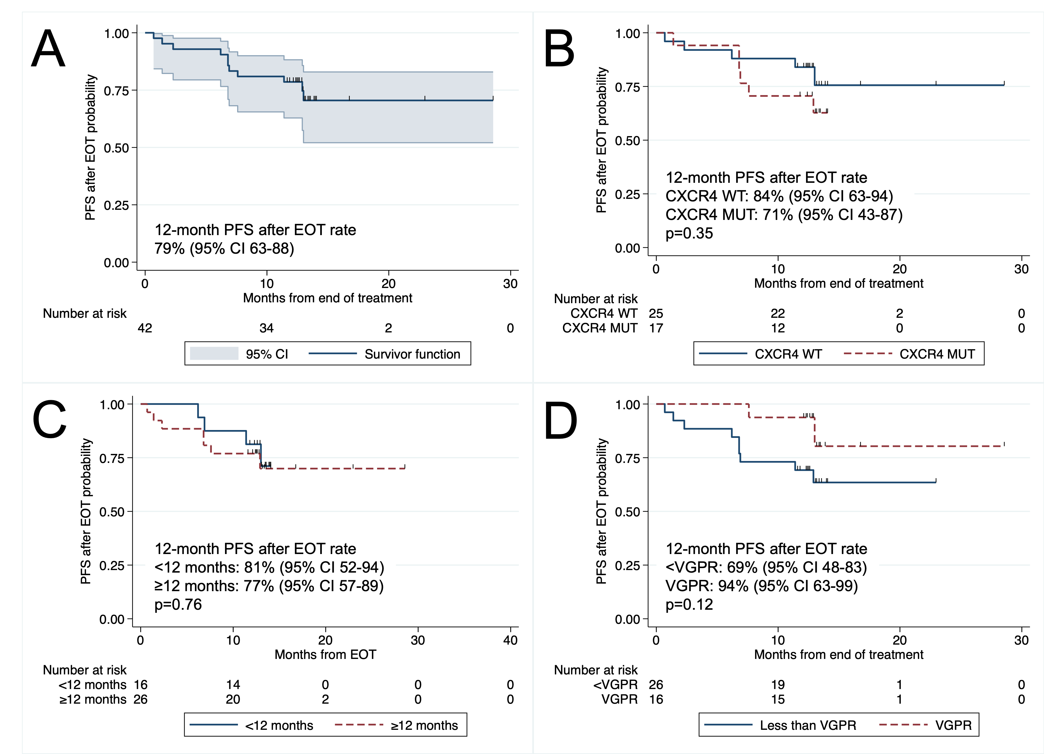
Ibrutinib and Venetoclax in Previously Untreated Waldenström Macroglobulinemia
Median follow-up:
24 months
Median time from EOT:
13 months
31 patients had a BMBX 1 year after EOT:
No BTK or TP53 mutations
Castillo et al. Submitted to ASH 2023

Slide 19
Efficacy of Pirtobrutinib, a Highly Selective, Non-Covalent (Reversible) BTK Inhibitor in Relapsed/Refractory Waldenström Macroglobulinemia: Results from the Phase 1/2 BRUIN Study
Response Evaluable WM Patients | Prior cBTKi n=63 | cBTKi Naïve n=17
Major Response Rateª, % (95% CI) | 66.7 (53.7-78.0) | 88.2 (63.6-98.5)
CR + VGPR Rate, % (95% CI) | 23.8 (14.0-36.2) | 29.4 (10.3-56.0)
Best Response
VGPR, n (%) | 15 (23.8) | 5 (29.4)
PR, n (%) | 27 (42.9) | 10 (58.8)
MR, n (%) | 9 (14.3) | 0 (0)
SD, n (%) | 9 (14.3) | 2 (11.8)
Palomba et al. ASH 2022: 229

Slide 20
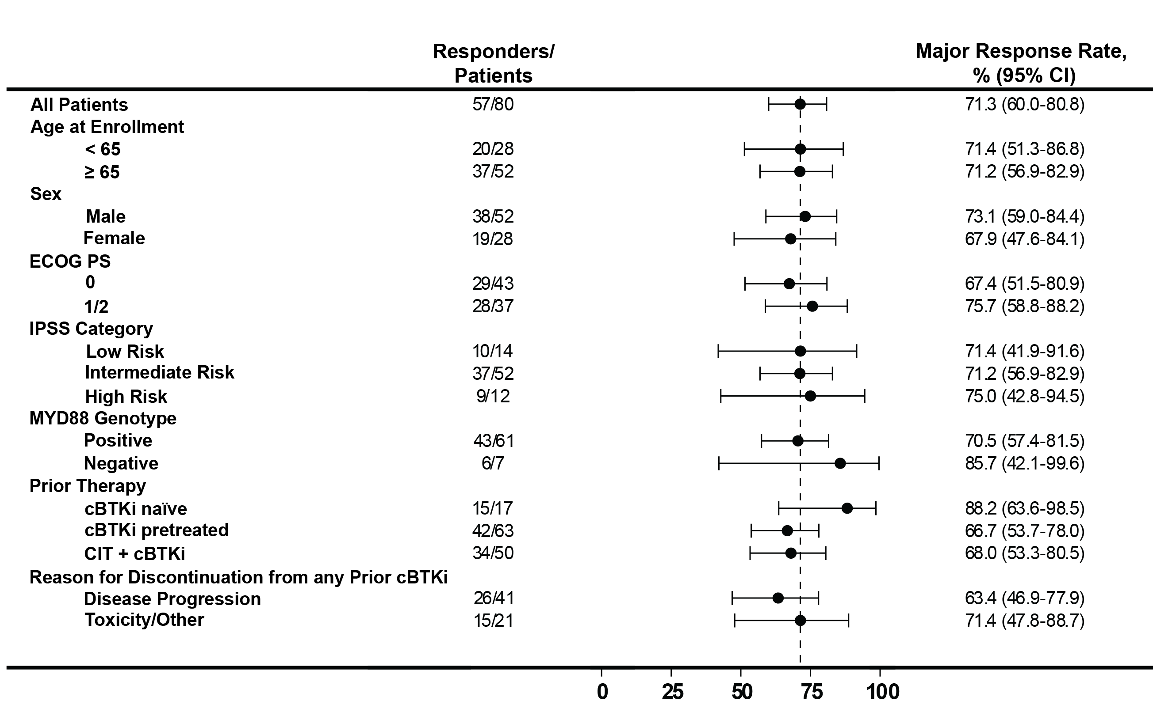
Efficacy of Pirtobrutinib, a Highly Selective, Non-Covalent (Reversible) BTK Inhibitor in Relapsed/Refractory Waldenström Macroglobulinemia: Results from the Phase 1/2 BRUIN Study
Palomba et al. ASH 2022: 229

Slide 21
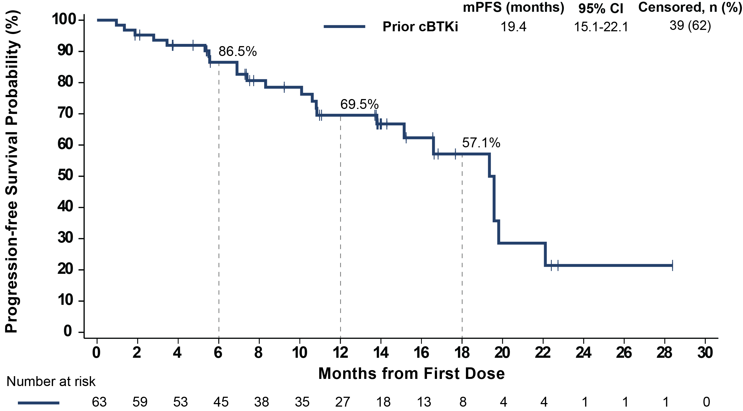
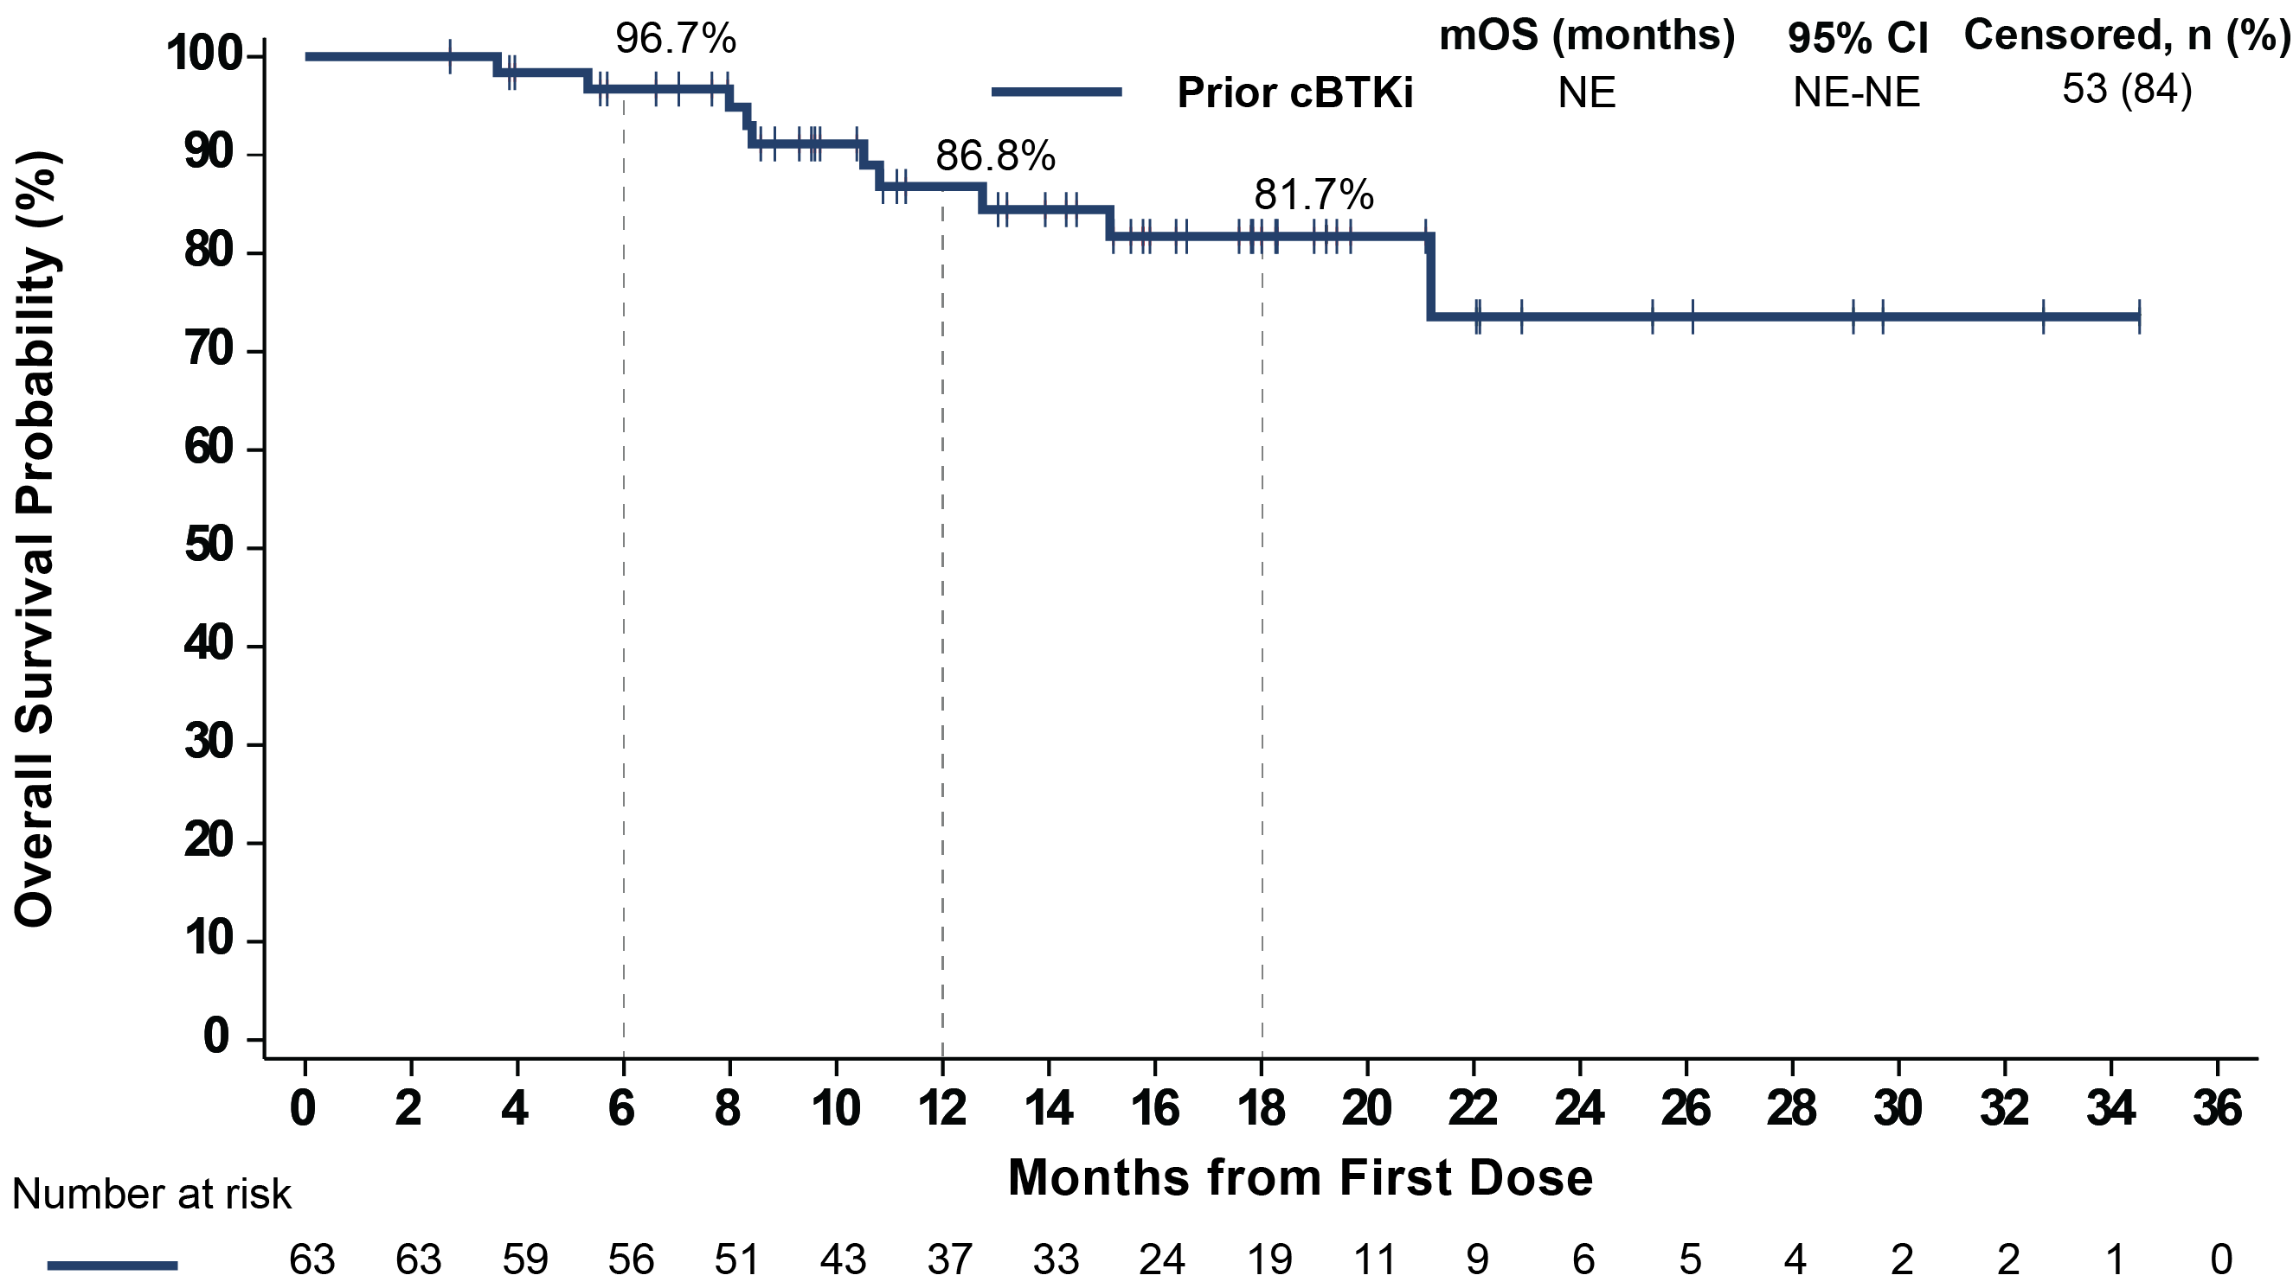
Efficacy of Pirtobrutinib, a Highly Selective, Non-Covalent (Reversible) BTK Inhibitor in Relapsed/Refractory Waldenström Macroglobulinemia: Results from the Phase 1/2 BRUIN Study
Progression-Free Survival
Overall Survival
Palomba et al. ASH 2022: 229
The median follow-up for PFS and OS in patients who received prior cBTKi was 14 and 16 months, respectively
55.6% (35/63) of patients who received prior cBTKi remain on pirtobrutinib

Slide 22
Efficacy of Pirtobrutinib, a Highly Selective, Non-Covalent (Reversible) BTK Inhibitor in Relapsed/Refractory Waldenström Macroglobulinemia: Results from the Phase 1/2 BRUIN Study
 | All Doses and Patients (N=773)
 | Treatment-Emergent AEs, (≥15%), % |  | Treatment-Related AEs, %
Adverse Event (AEs) | Any Grade | Grade ≥ 3 | Any Grade | Grade ≥ 3
Fatigue | 28.7% | 2.1% | 9.3% | 0.8%
Diarrhea | 24.2% | 0.9% | 9.3% | 0.4%
Neutropeniaª | 24.2% | 20.4% | 14.7% | 11.5%
Contusion | 19.4% | 0.0% | 12.8% | 0.0%
Cough | 17.5% | 0.1% | 2.3% | 0.0%
Covid-19 | 16.7% | 2.7% | 1.3% | 0.0%
Nausea | 16.2% | 0.1% | 4.7% | 0.1%
Dyspnea | 15.5% | 1.0% | 3.0% | 0.1%
Anemia | 15.4% | 8.8% | 5.2% | 2.1%
AEs of Special Interest^{b} | Any Grade | Grade ≥ 3 | Any Grade | Grade ≥ 3
Bruising^{c} | 23.7% | 0.0% | 15.1% | 0.0%
Rash^{d} | 12.7% | 0.5% | 6.0% | 0.4%
Arthralgia | 14.4% | 0.6% | 3.5% | 0.0%
Hemorrhage/Hematoma^{e} | 11.4% | 1.8% | 4.0% | 0.6%
Hypertension | 9.2% | 2.3% | 3.4% | 0.6%
Atrial fibrillation/flutter^{f,g} | 2.8% | 1.2% | 0.8% | 0.1%
  Median time on treatment for the overall safety population was 9.6 months
  Discontinuations due to treatment-related AEs occurred in 2.6% (n=20) of all patients
  Dose reductions due to treatment-related AEs occurred in 4.5% (n=35) of all patients
Palomba et al. ASH 2022: 229

Slide 23
Waldenström macroglobulinemia: summary
IVEN IVEN induced a 42% VGPR and 12-month PFS rate of 92% in untreated WM. 4 patients had ventricular arrhythmia prompting study therapy termination. | Pirtobrutinib Pirtobrutinib was effective with 67% major response rate in WM patients previously exposed to covalent BTK inhibitors. Median PFS appears short at 19 months.

Slide 24
Marginal Zone Lymphoma

Slide 25
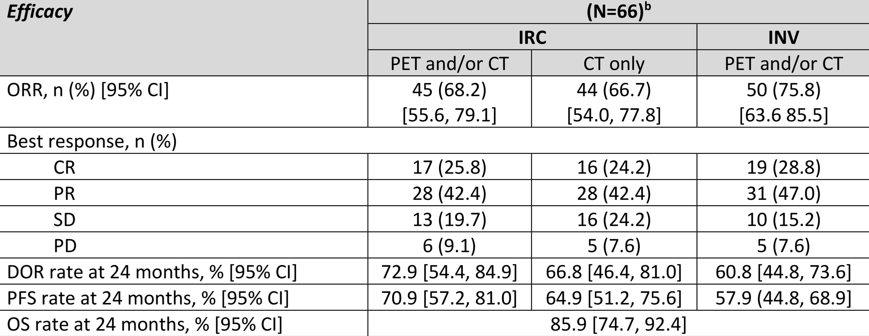
Long-Term Efficacy and Safety of Zanubrutinib in Patients with Relapsed/Refractory (R/R) Marginal Zone Lymphoma (MZL): Final Analysis of the Magnolia (BGB-3111-214) Trial
Opat et al. ASH 2022: 234

Slide 26
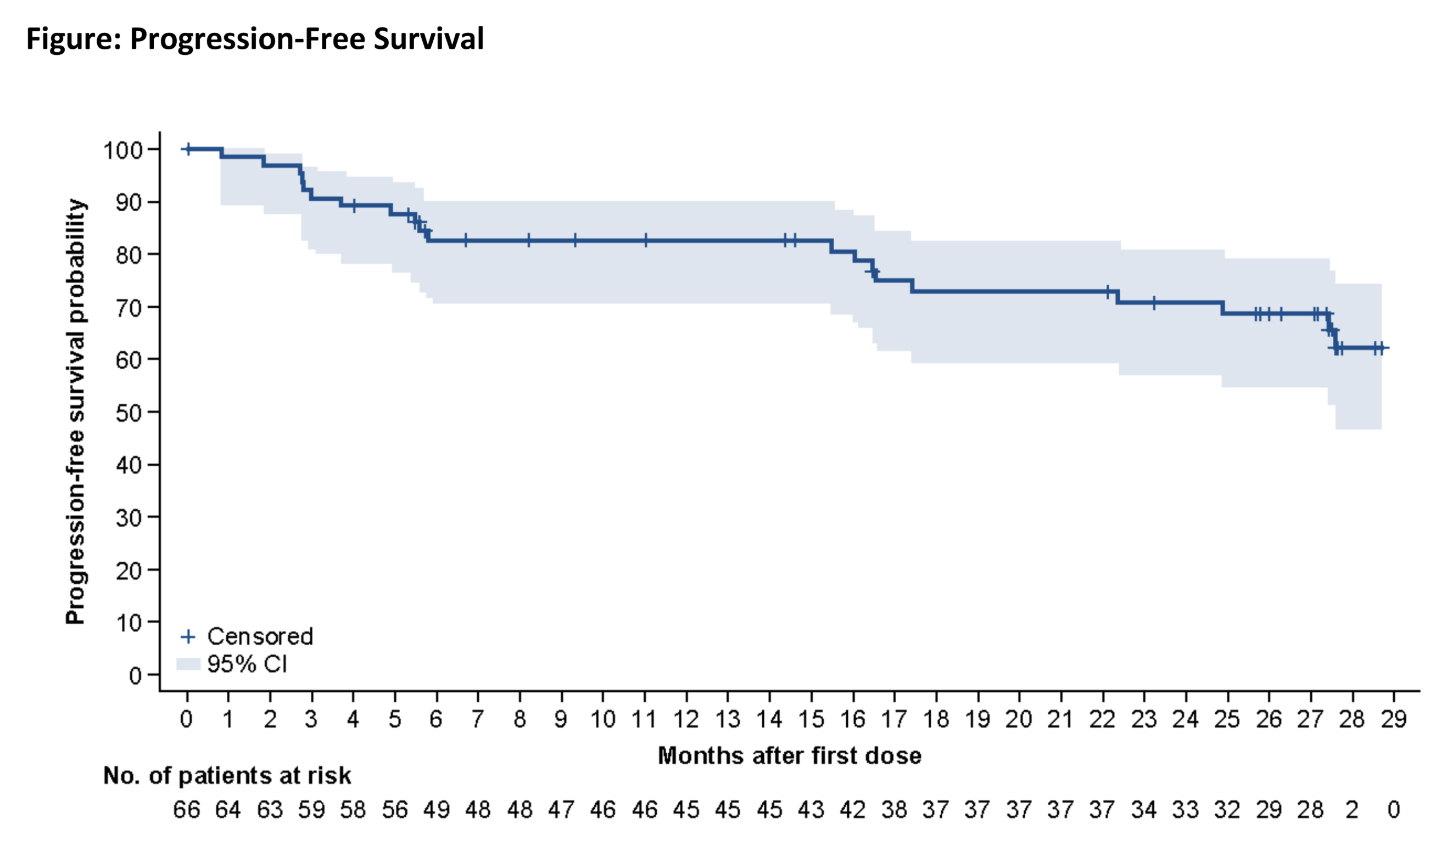
Long-Term Efficacy and Safety of Zanubrutinib in Patients with Relapsed/Refractory (R/R) Marginal Zone Lymphoma (MZL): Final Analysis of the Magnolia (BGB-3111-214) Trial
AE in ≥15% of patients
Bruising 24%
Diarrhea 22%
Constipation 18%
Arthralgia 15%
Pyrexia 15%
Grade >3 AE
Neutropenia 9%
COVID-19 pneumonia 6%
AECI
Hypertension 4%
Atrial fibrillation 1.5%
Atrial flutter 1.5%
2-year PFS rate: 70%

Slide 27
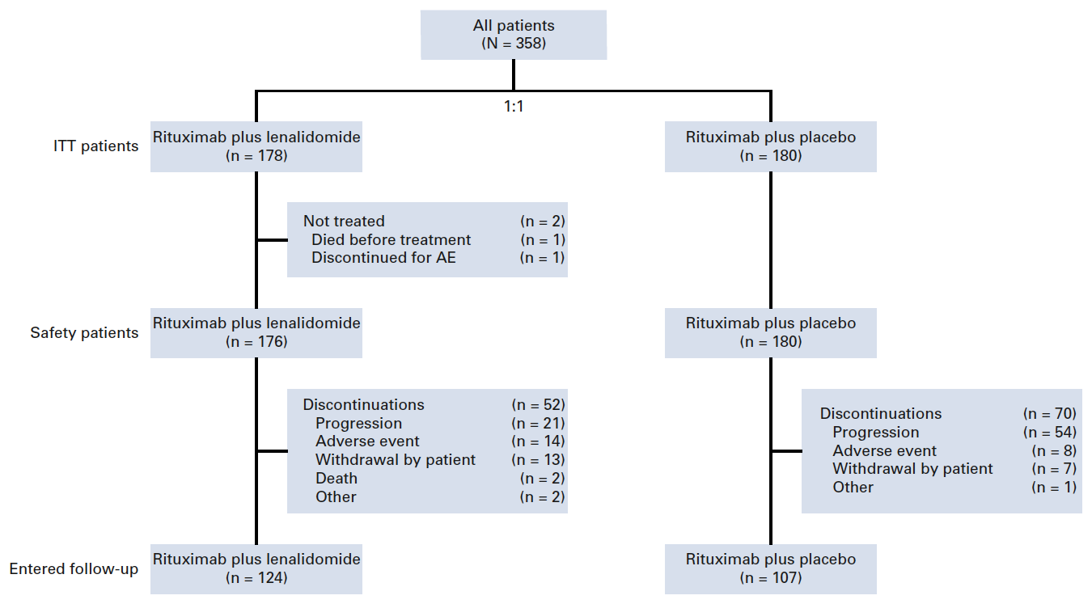
Five-Year Results and Overall Survival Update from the Phase 3 Randomized Study AUGMENT: Lenalidomide Plus Rituximab (R²) Vs Rituximab Plus Placebo in Patients with Relapsed/Refractory Indolent Non-Hodgkin Lymphoma

Slide 28
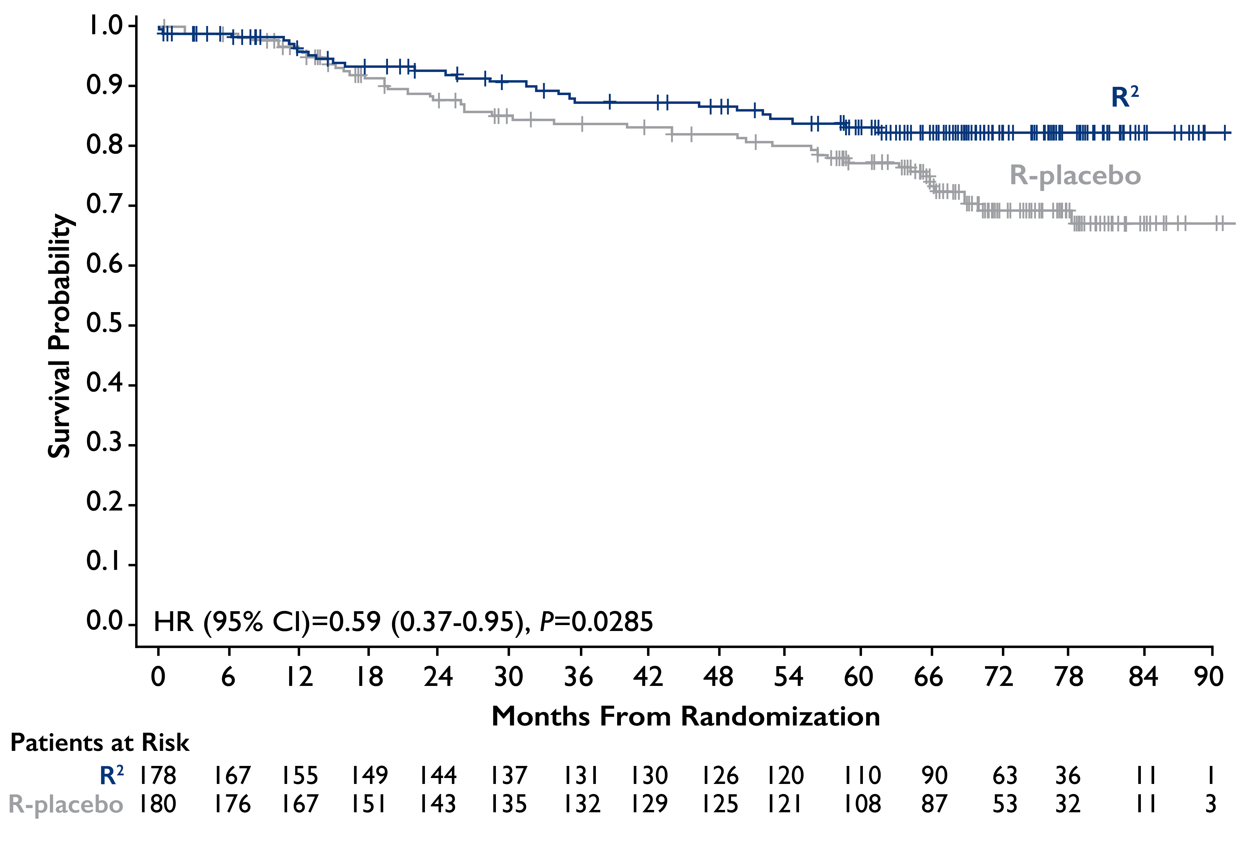
Five-Year Results and Overall Survival Update from the Phase 3 Randomized Study AUGMENT: Lenalidomide Plus Rituximab (R²) Vs Rituximab Plus Placebo in Patients with Relapsed/Refractory Indolent Non-Hodgkin Lymphoma
Median TTNT
R2 73 months
R-placebo 32 months
Rate of SPM
R² 7%
R-placebo 12%
Incidence HT
R2 1.2%
R-placebo 1.8%
5-year OS rate:
R² 83%
R-placebo 77%
Leonard et al. ASH 2022: 230

Slide 29
Marginal zone lymphoma: summary
MAGNOLIA Zanubrutinib in R/R MZL induced ORR 68%, CR 26%, 24-month PFS rate 71% AEs consistent with previous experiences | AUGMENT 5-year OS rate and median TTNT favor R² over R-placebo No difference in SPM and HT between arms

Slide 30
Best of ASH 2022:
Indolent lymphomas
Jorge J. Castillo, MD
Associate Professor of Medicine
Harvard Medical School
JorgeJ_Castillo@dfci.harvard.edu

